Slide 1
The IBM Quantum Computing Challenge
Lab 0 | Lab 1
By: Jack Sullivan, Chris Choi, Robert Wu
Notes:
ROBERT: Introduce us

Slide 2
What is the IBM Quantum Computing Challenge
“Welcome to the IBM Quantum Challenge, the annual code challenge focused on how to use Qiskit. Whether you’re a newcomer or a seasoned veteran, there is something here for you.
The Quantum Challenge consists of a series of Jupyter notebooks that contain tutorial material, code examples, and auto-graded coding challenges for you to fill in. We call each of these notebooks a ‘lab’. “
Notes:
ROBERT: Explain that the words on the slides is the definition that IBM gave the program, and just give a general rundown

Slide 3
Lab 0: Overview
The workflow of Qiskit pattern: Set up, Optimize, Run, and Process your circuit.
Create a two-qubit Bell state and show that it is properly entangled by visualizing the operators.
Notes:
Robert: This lab, alongside showing us the basics of how to work with the labs and grader, will have us learn the basic qiskit workflow pattern, and we will use it to test a quantum entanglement of 2 qubits

Slide 4
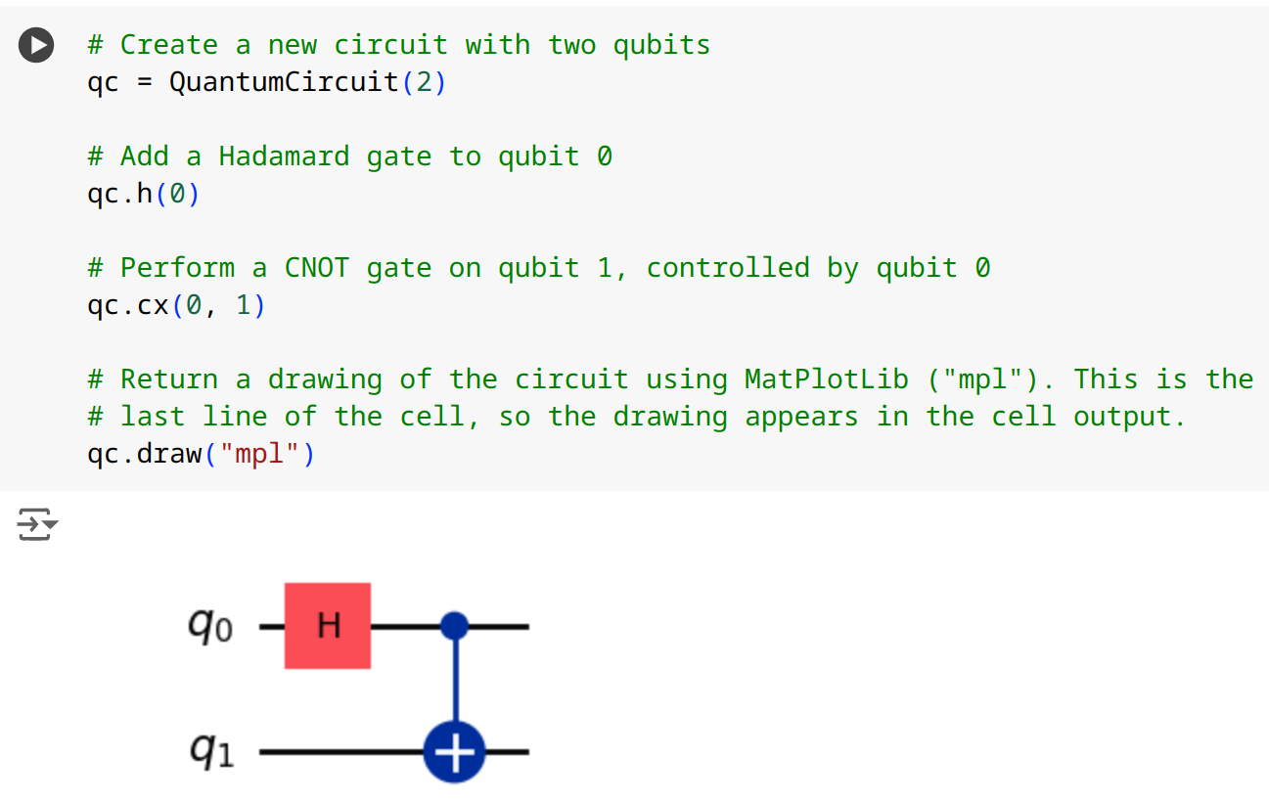
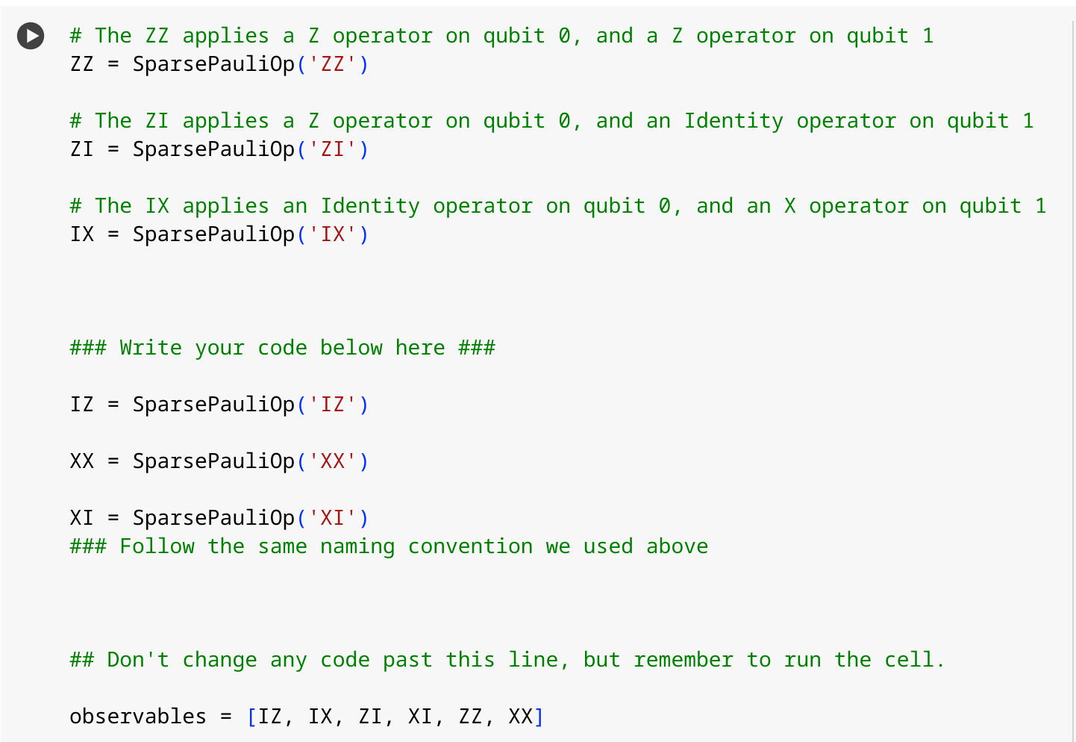
Step 1: Map our Circuits and Operators
Circuit
Operators
Circuit
Notes:
Chris: The left is a Quantum Circuit that produces a Bell State. What this means is that while the measurement of the first Qubit is still 50/50 for 1 or 0, once measured it guarantees the second Qubit must match.
We then make operators to test that our circut does what it is supposed to do. We should have an expectation value of 0 from 1 qubit operations and a value of 1 from 2 qubit operations (explain why)

Slide 5
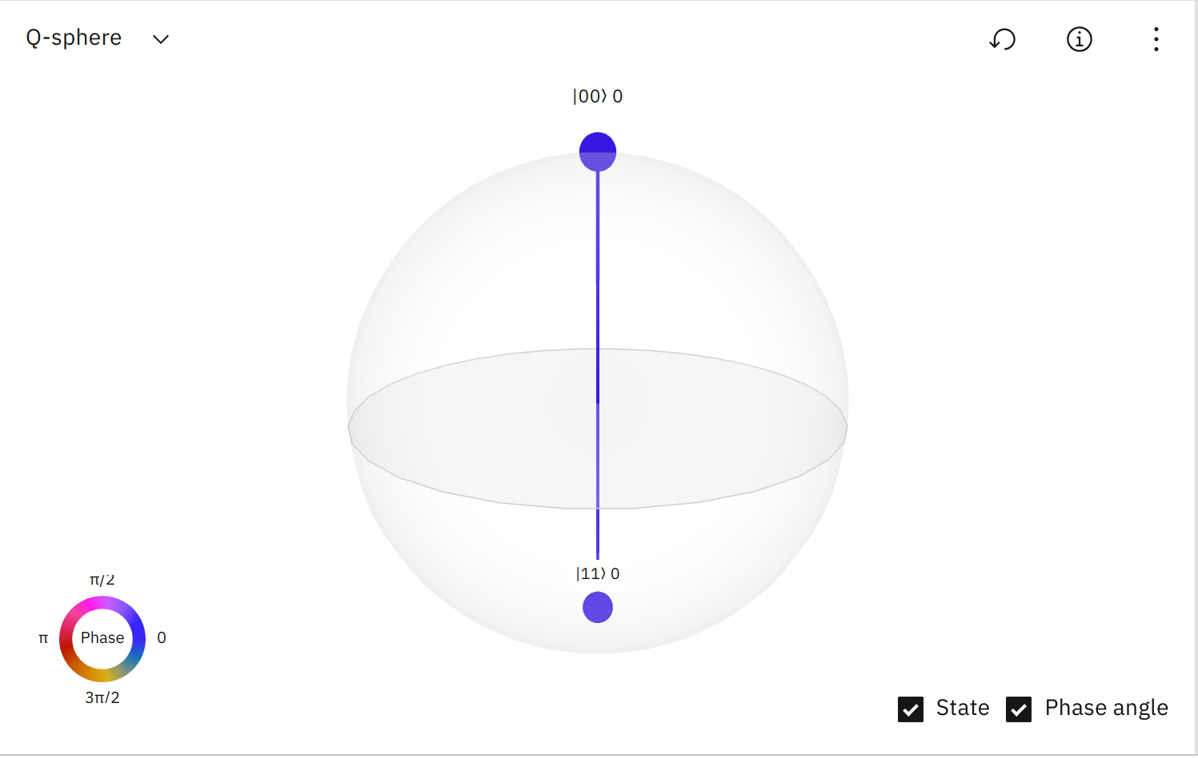
Bell State
Notes:
Chris: This is it tada

Slide 6
Step 2: Optimize
Optimization is done using transpliers.
They are able to reduce the number of gates required, and ensure the structure of gates will work on the machine being used.
Notes:
Robert: Just explain the slide

Slide 7
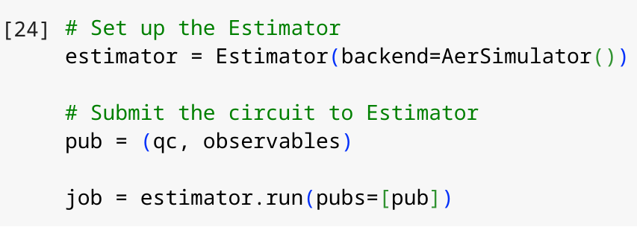
Step 3: Execute
Estimator: A function (primitives) that estimates the output of a quantum circuit
Aer Simulator: A fake quantum computer backend
qc: Our quantum circuit
observables: Our operations to run on the circuit
Notes:
Chris:

Slide 8
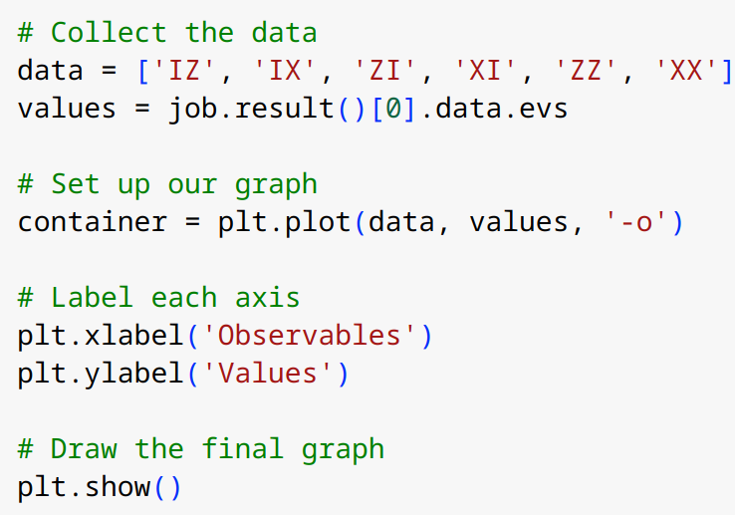
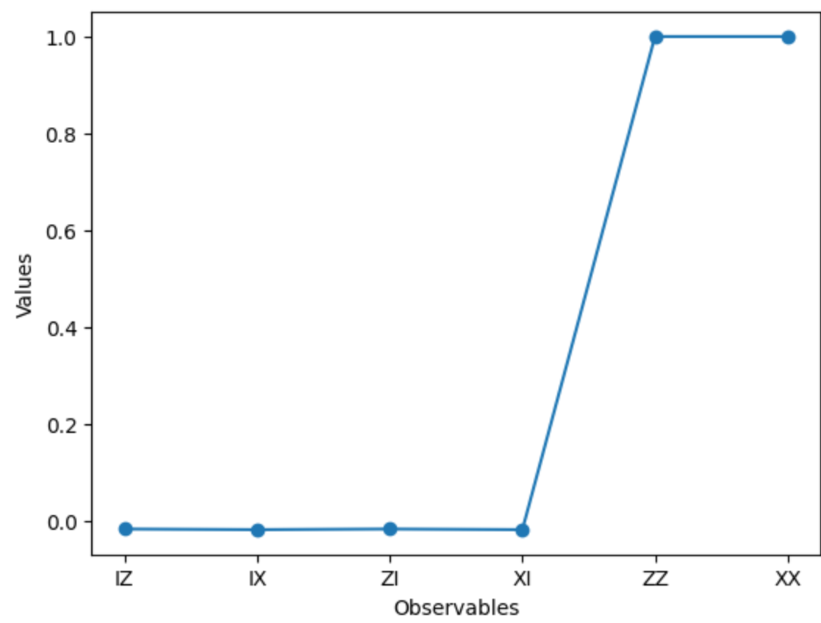
Step 4: Post Process the results
Notes:
Chris: Taking the data we received from the estimator, we can plot the values received based on operation. We can see that when we measured only 1 qubit, we were unable to estimate the result. But when we measured 2, we were able to estimate the final result as once we know the first qubit, we know the second due to entanglement.

Slide 9
Lab 1: Overview
Qiskit states, the new and the old
VQE with Qiskit 1.0
Notes:
Chris: We go over the basics of the new version of Qiskit. We will then go into making a VQE, we wil ltalk about that later

Slide 10
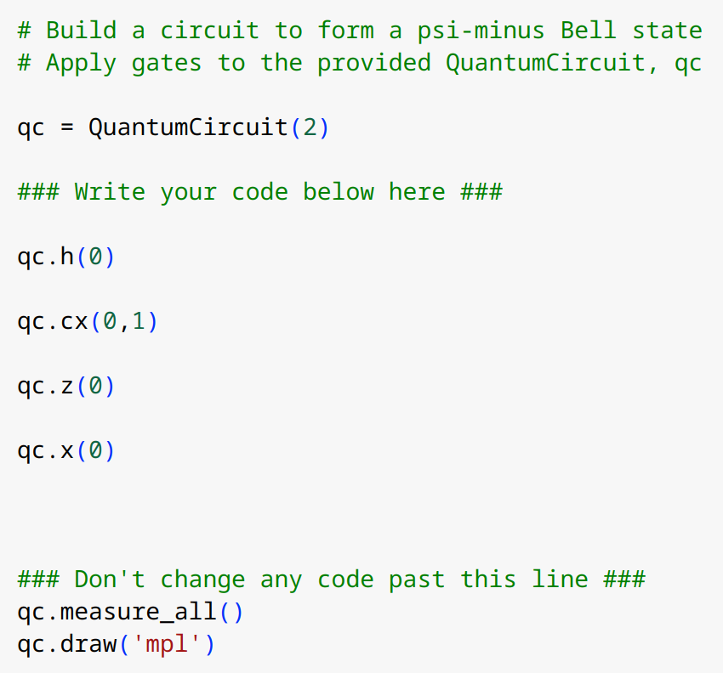
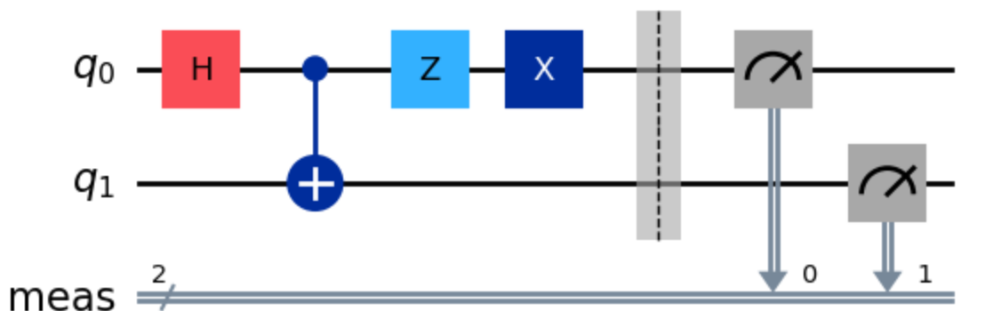
Step 1: Create and Draw a singlet Bell state Circuit
Notes:
Chris: The code seen on the left is the qiskit code that results in a

Slide 11
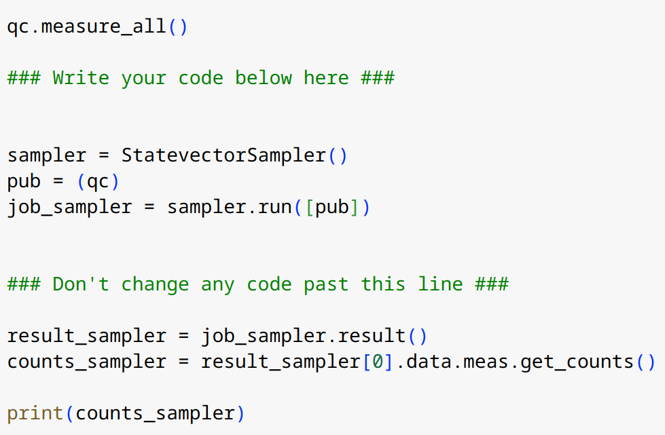
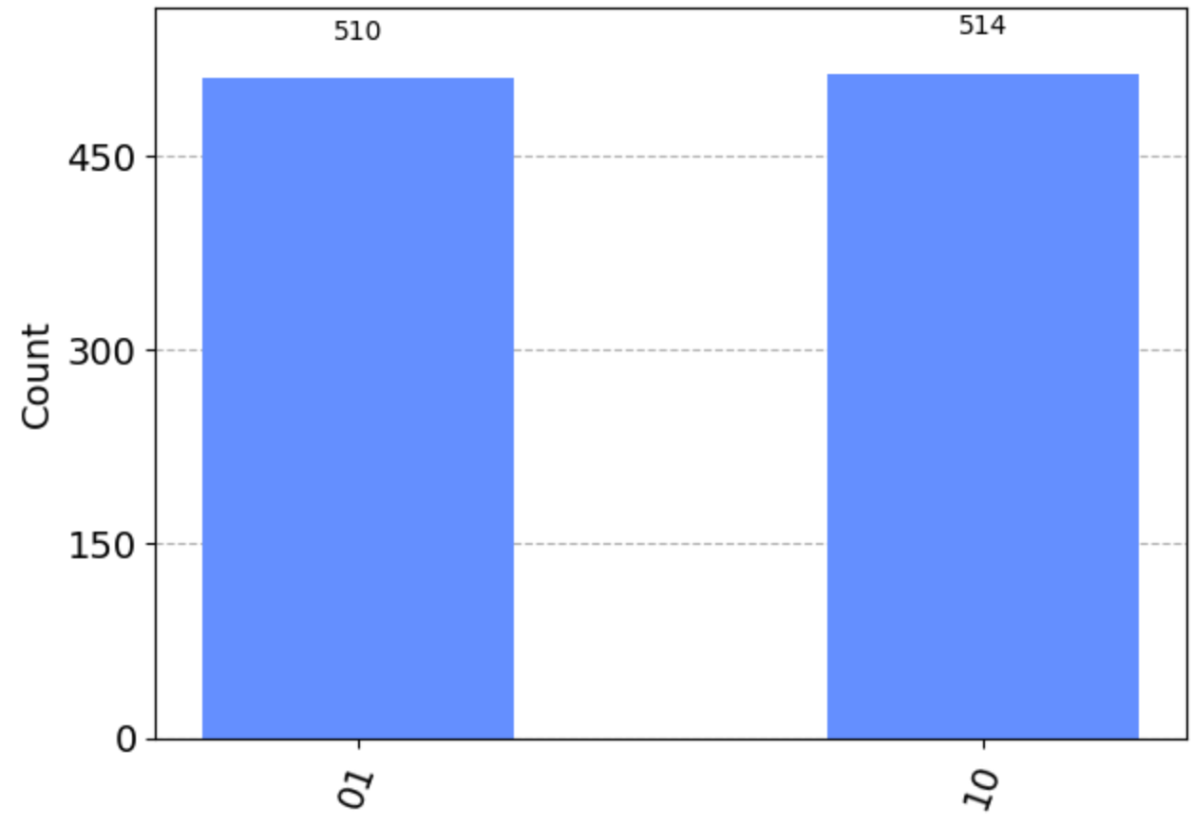
Step 2: Run it with Sampler
Notes:
Jack: We use the Qiskit Sampler primitive, the StatevectorSampler, to see probability distribution (primitative is just a small amount of processing instructions.) (StateVectorSampler just returns state vectors)

Slide 12
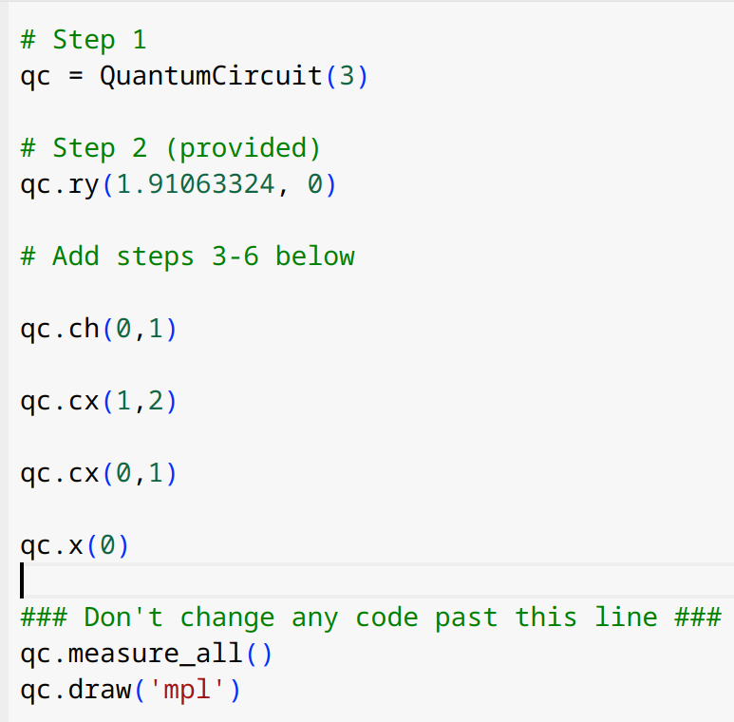
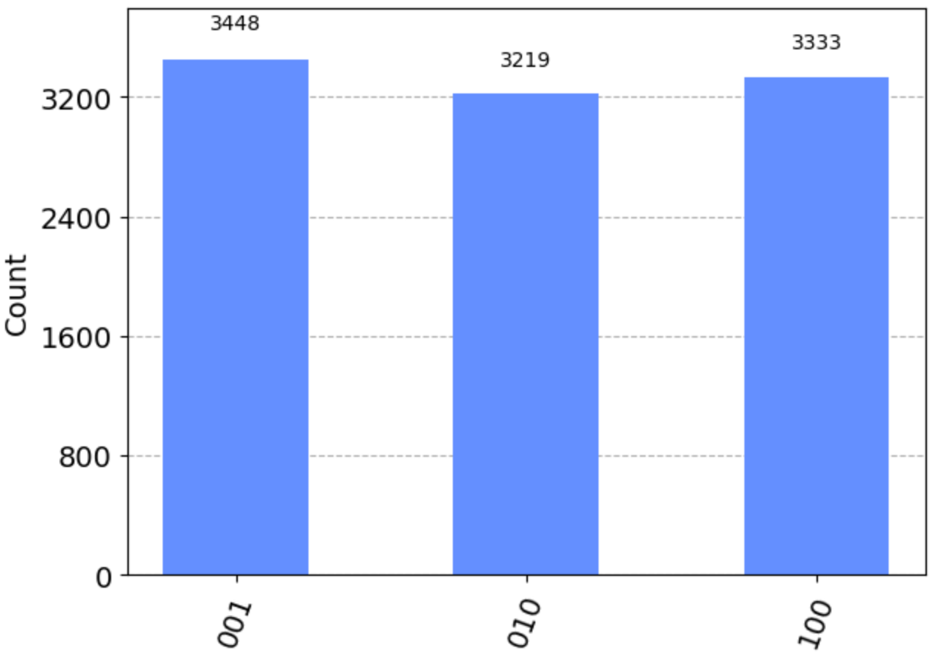
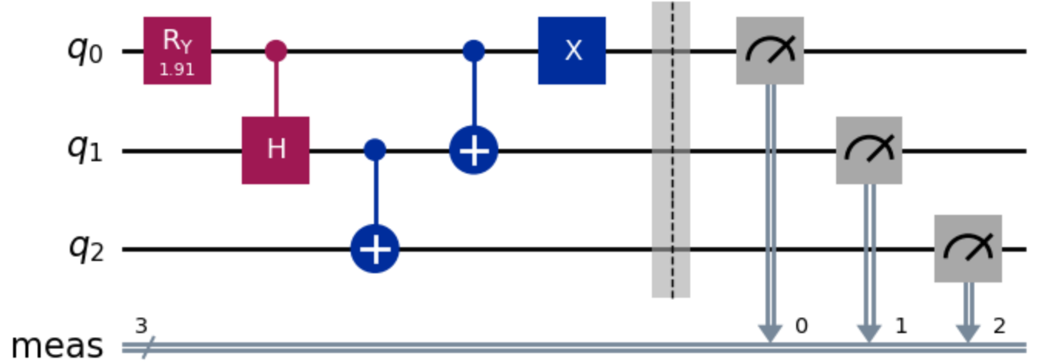
Step 3: Create and draw a W-state circuit
Notes:
Jack: W state circuits are just engangeled circuits that have W possible states.

Slide 13
Dive into VQE
VQE: Variational Quantum Eigensolver.
Executing a VQE algorithm requires these three steps:
Setting up the Hamiltonian and ansatz (problem specification)
Implementing the Qiskit Runtime estimator
Adding the Classical optimizer and running our program
https://en.wikipedia.org/wiki/Variational_quantum_eigensolver
https://www.youtube.com/watch?v=TUFovZsBcW4
Notes:
Jack: A quantum and classical algorithm that allows us to find the ground state of a given system

Slide 14
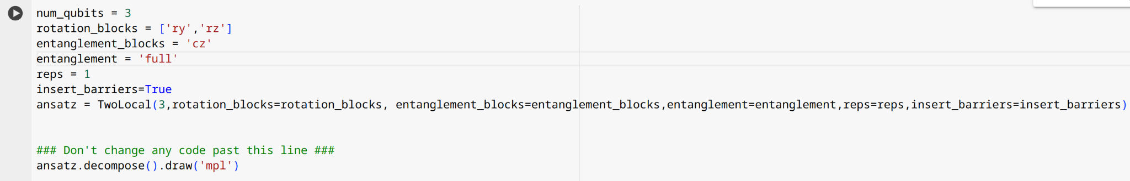
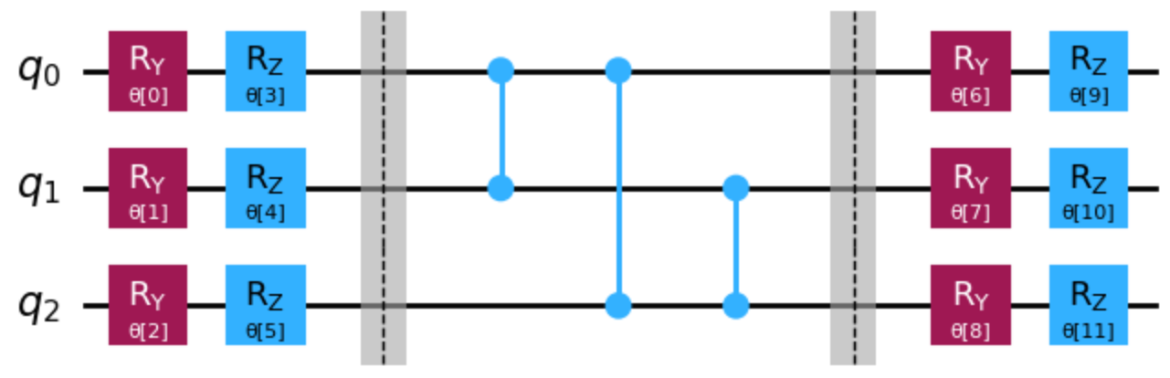
Step 1: Create a parameterized circuit to serve as the ansatz
Notes:
Jack: We used a TwoLocal circuit, which is just a type of circuit that automatically entangles all qubits depending on parameters given

Slide 15
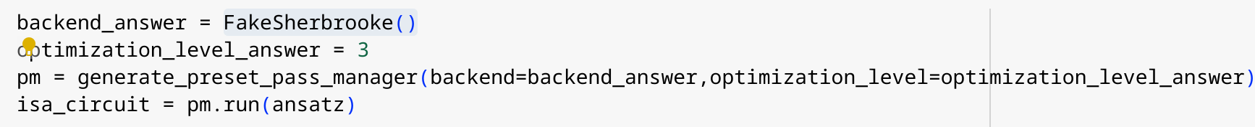
Step 2: Transpile to ISA circuits
Instruction Set Architecture (ISA): The set of instructions the device can understand and execute.
Notes:
Jack: Most times you design a circut, the way you lay it out wouldnt work on quantum hardware or would be the most efficient. Transpiling it allows us to change the circut to the devices ISA or Instruction Set Archiceture. For this we will model it off the backend FakeSherbrooke() which is a 127 qbit backend

Slide 16
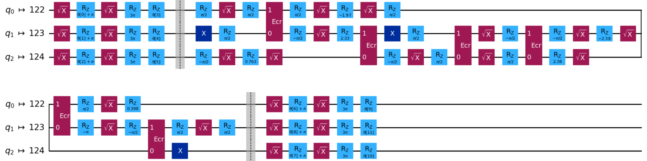
Notes:
Jack:

Slide 17
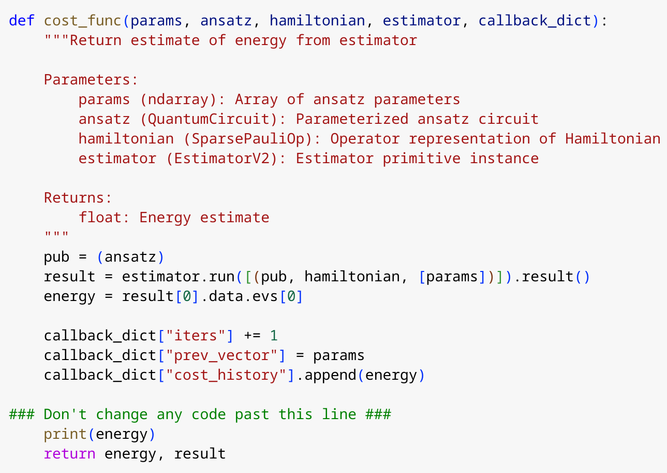
Step 3: Define a cost function
Notes:
Jack: In order to have something to optimize, we need a metric to optmize. For this we will use energy of a given state

Slide 18
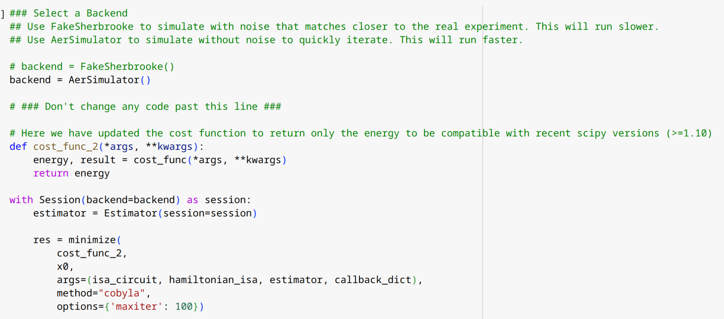
Step 4: Run it
Notes:
Jack: We then take the estimator and run it. Everytime we run it we change the parameters of the function based on the output using a classical optimization procedure SciPy routines.
Once we do that, we see this data.

Slide 19
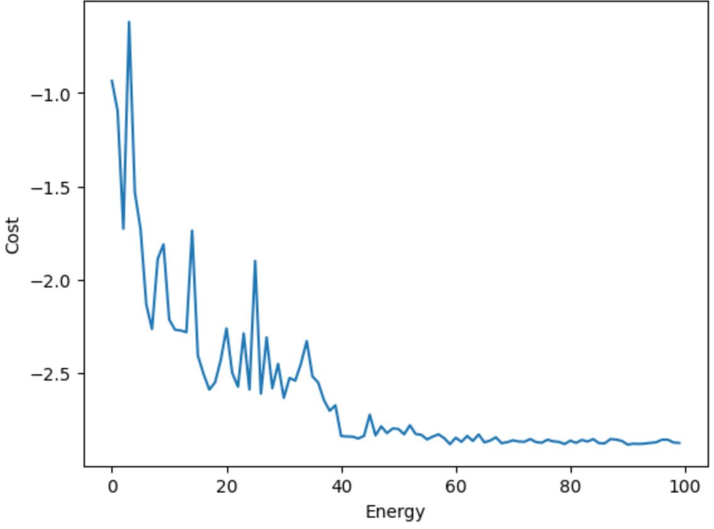
Data
Notes:
Jack: We see that as the function ran, we eventually optimized to our ground state.

Slide 20
Thank you!
Notes:
Robert: thank you any questions

